Slide 1
BLOCKCHAIN-BASED SECURED VOTING SMART CONTRACT
TEAM MEMBERS
NAAFIAH FATHIMA
MADHI VATHANI N
SUBATHRA J
POOJA V
UDAYARAVINA R

Slide 2
ABSTRACT
In an era of advancing digital technology and increasing demands for transparency and security in the voting process, the emergence of a Voting DApp (Decentralized Application marks a significant evolution in the way elections and decision-making events are conducted. This innovative blockchain-based solution revolutionizes the traditional voting system by leveraging the power of decentralization, immutability, and cryptographic security. The Voting DApp empowers individuals to cast their votes from the comfort of their own devices.

Slide 3
PROBLEM STATEMENT
In traditional voting systems, there exist numerous challenges that undermine the integrity and accessibility of democratic processes. Issues such as voter fraud, ballot manipulation, and limited accessibility for remote or physically challenged individuals have persistently plagued the conventional voting methods. Moreover, the centralized nature of these systems raises concerns about data security, transparency, and the potential for interference.

Slide 4
PROPOSED SOLUTION
Our voting DApp empowers individuals to participate in transparent and secure digital elections. Leveraging blockchain technology, our platform ensures the integrity of every vote, guaranteeing tamper-proof records and anonymous voting. Through a user-friendly interface, voters can easily cast their ballots, and our governance mechanism ensures fair and decentralized decision-making. We're committed to enhancing democracy, fostering trust, and enabling wider civic engagement through our innovative voting DApp.

Slide 5
Remix serves as a vital tool. This web-based Integrated Development Environment (IDE), designed for Solidity, facilitates the creation and testing of smart contracts that govern the DApp's voting process.
MetaMask into your voting DApp is a fundamental step to facilitate user interactions with the Ethereum blockchain. By guiding users to set up and install the MetaMask browser extension, you enable them to create or import Ethereum wallets seamlessly. Utilizing JavaScript libraries like Web3.js or Ethers.js, your DApp can connect to MetaMask, providing functionalities to send transactions and interact with smart contracts.

Slide 6
OUTPUT SNAPSHOTS

Slide 7
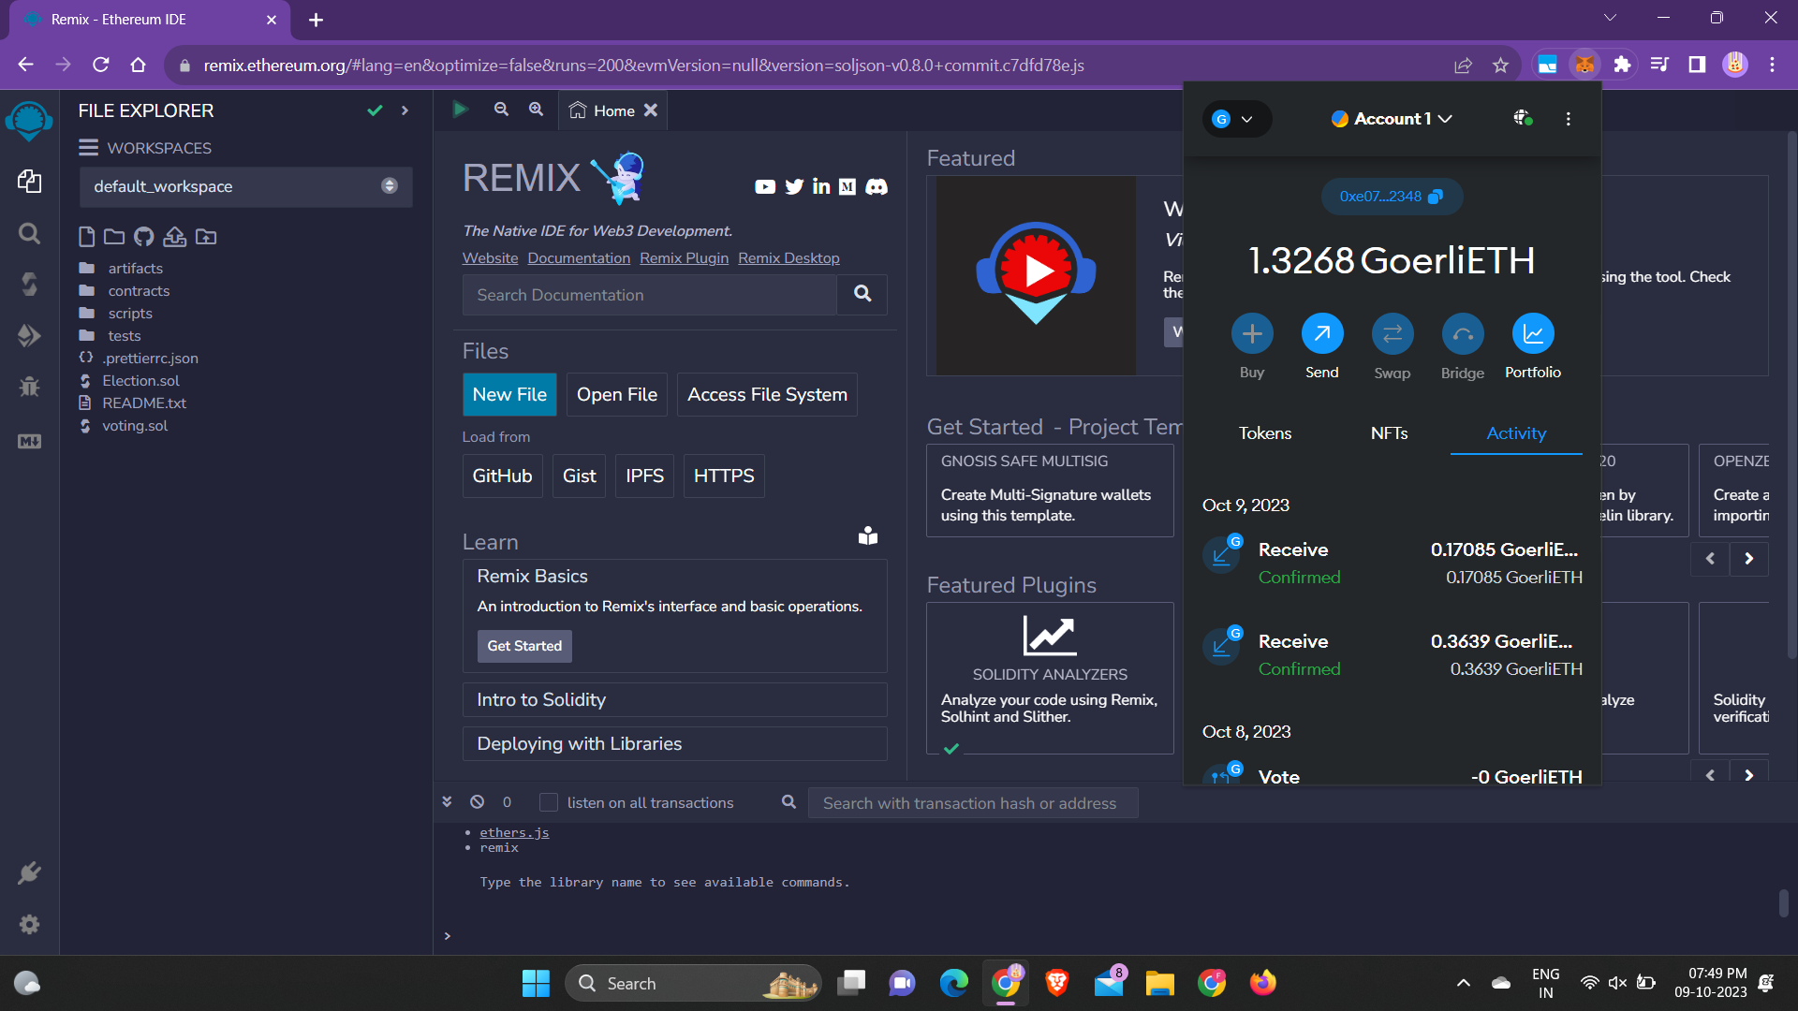

Slide 8
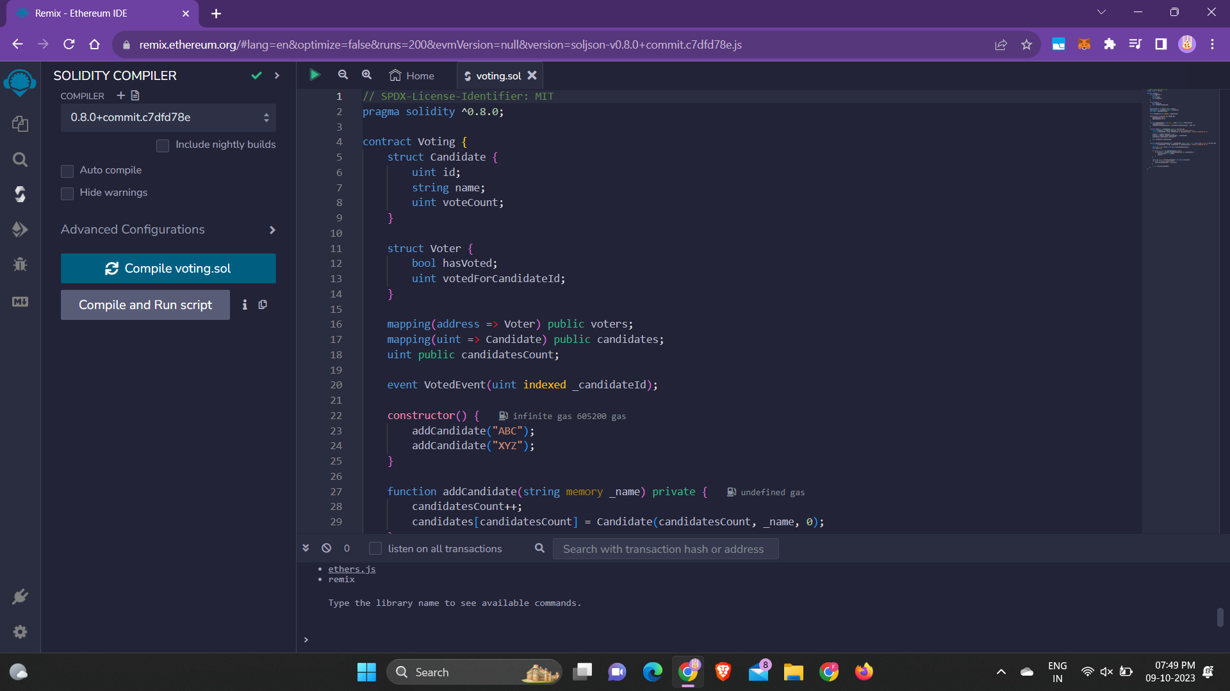

Slide 9
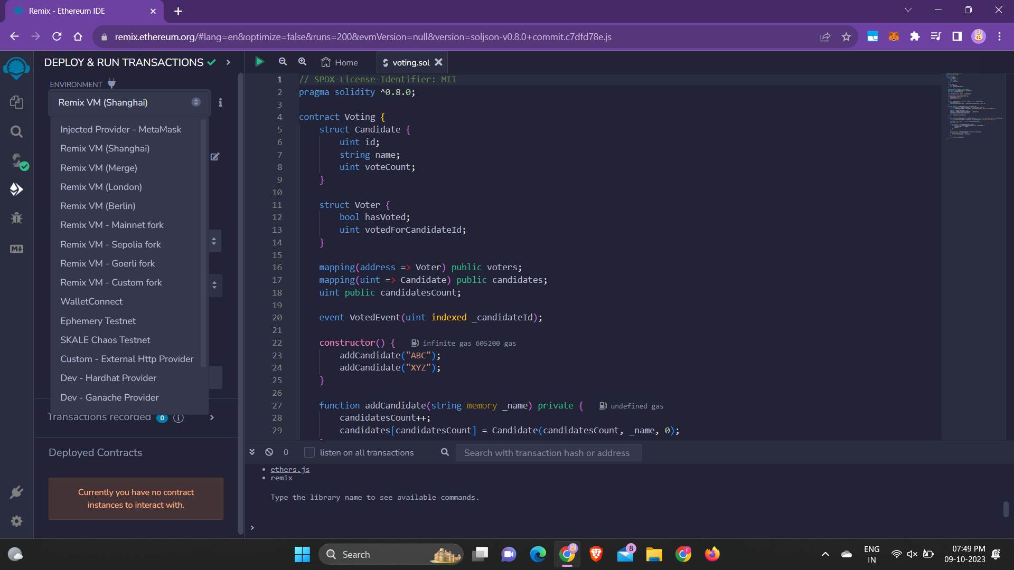

Slide 10
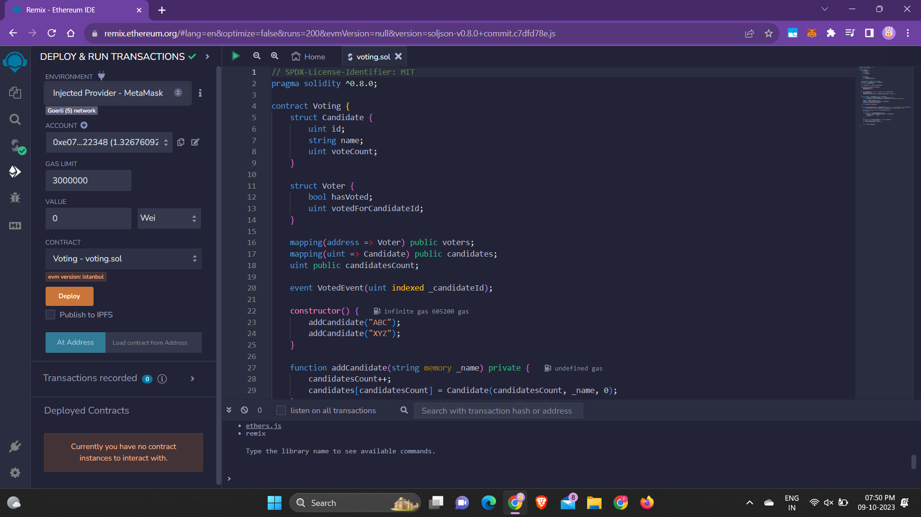

Slide 11
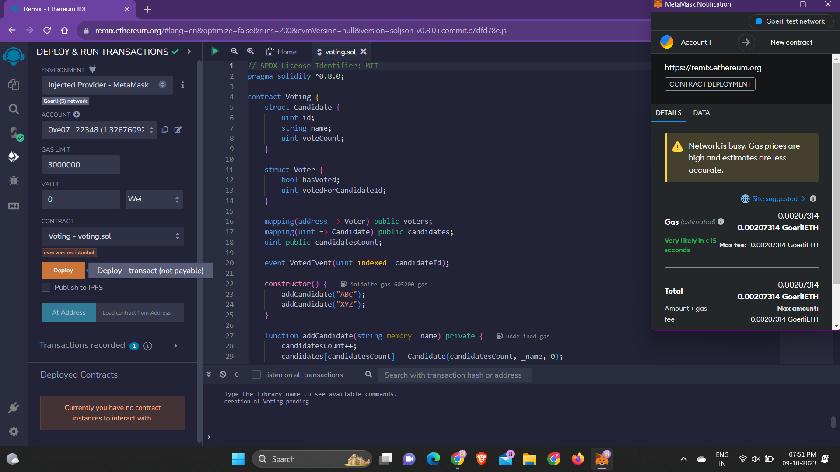

Slide 12
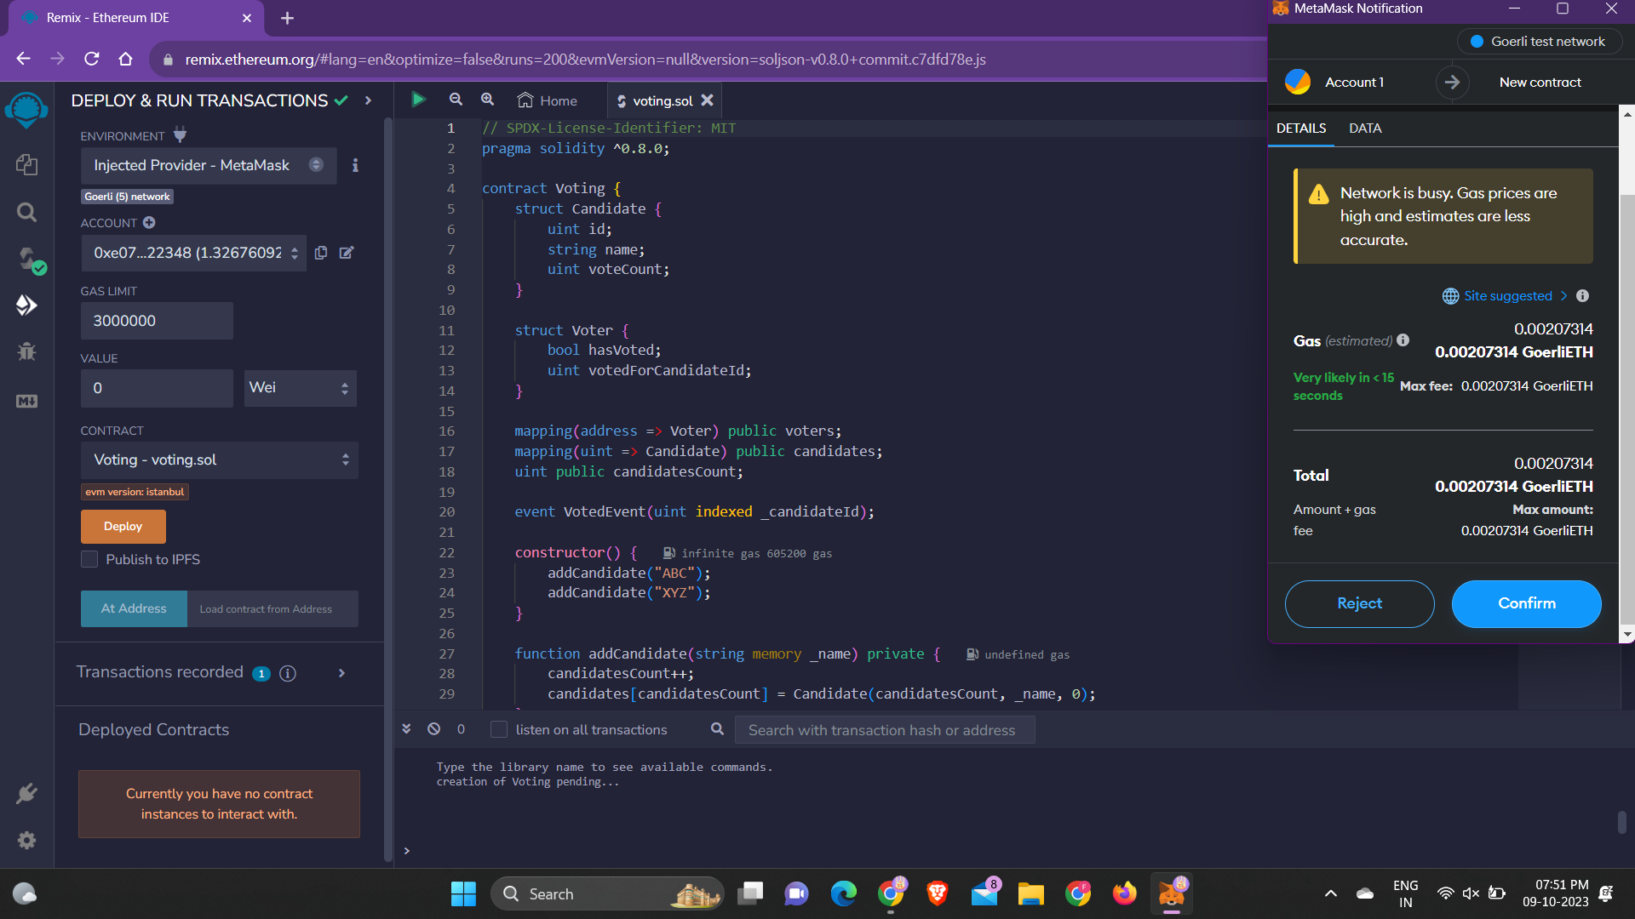

Slide 13
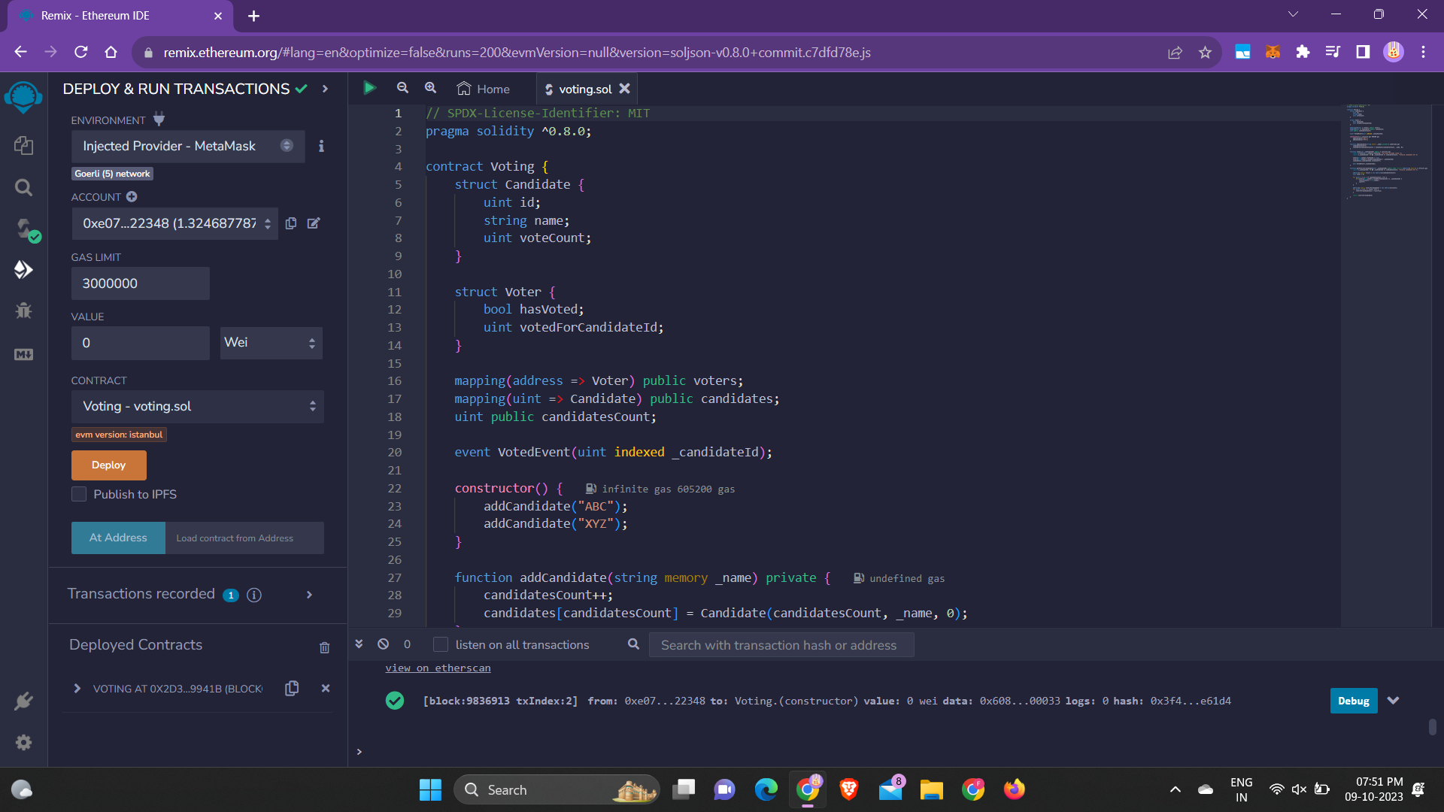

Slide 14
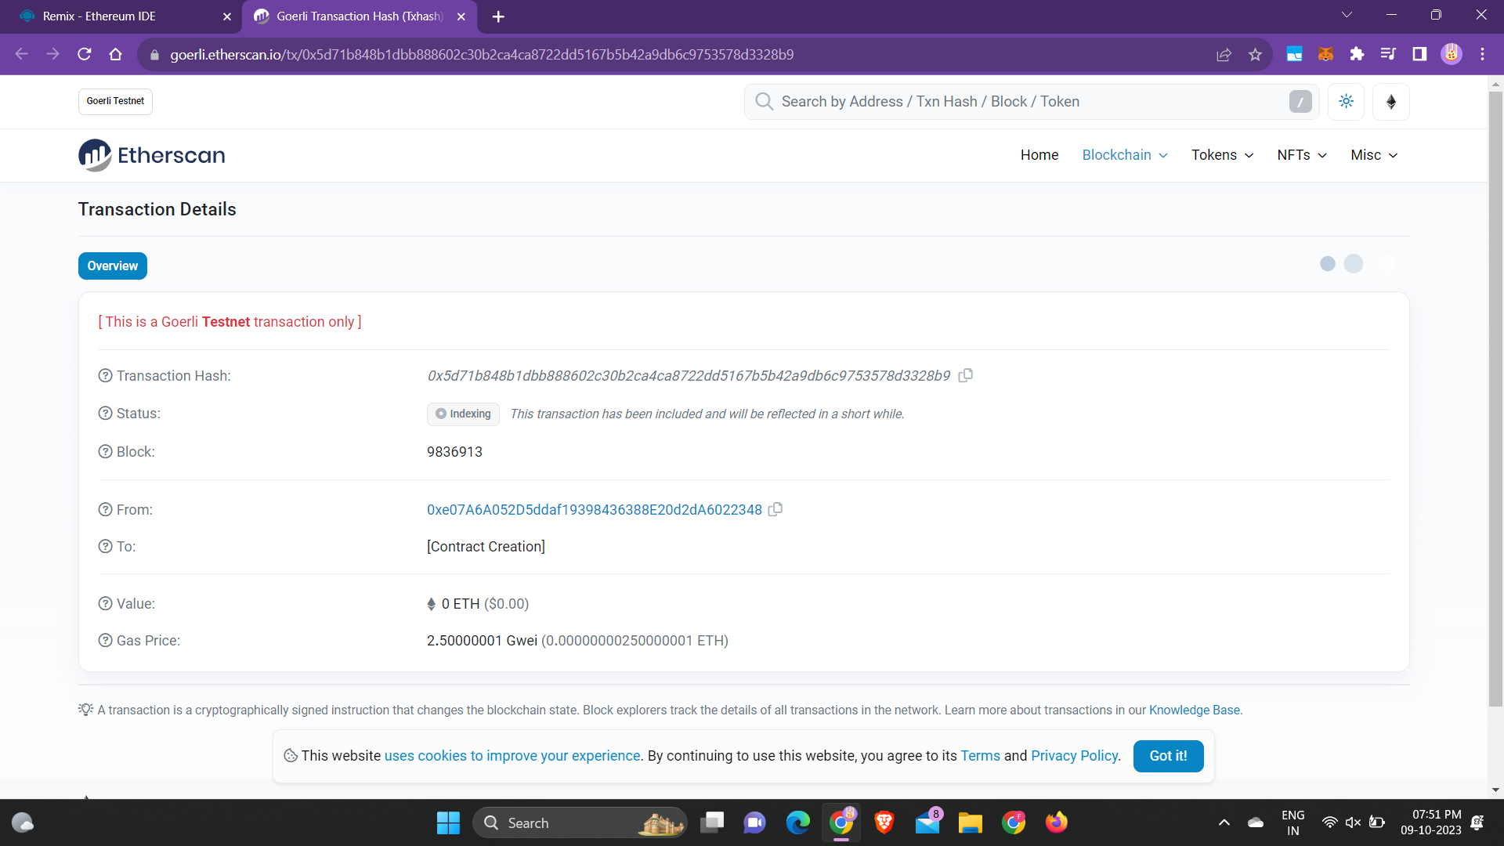

Slide 15
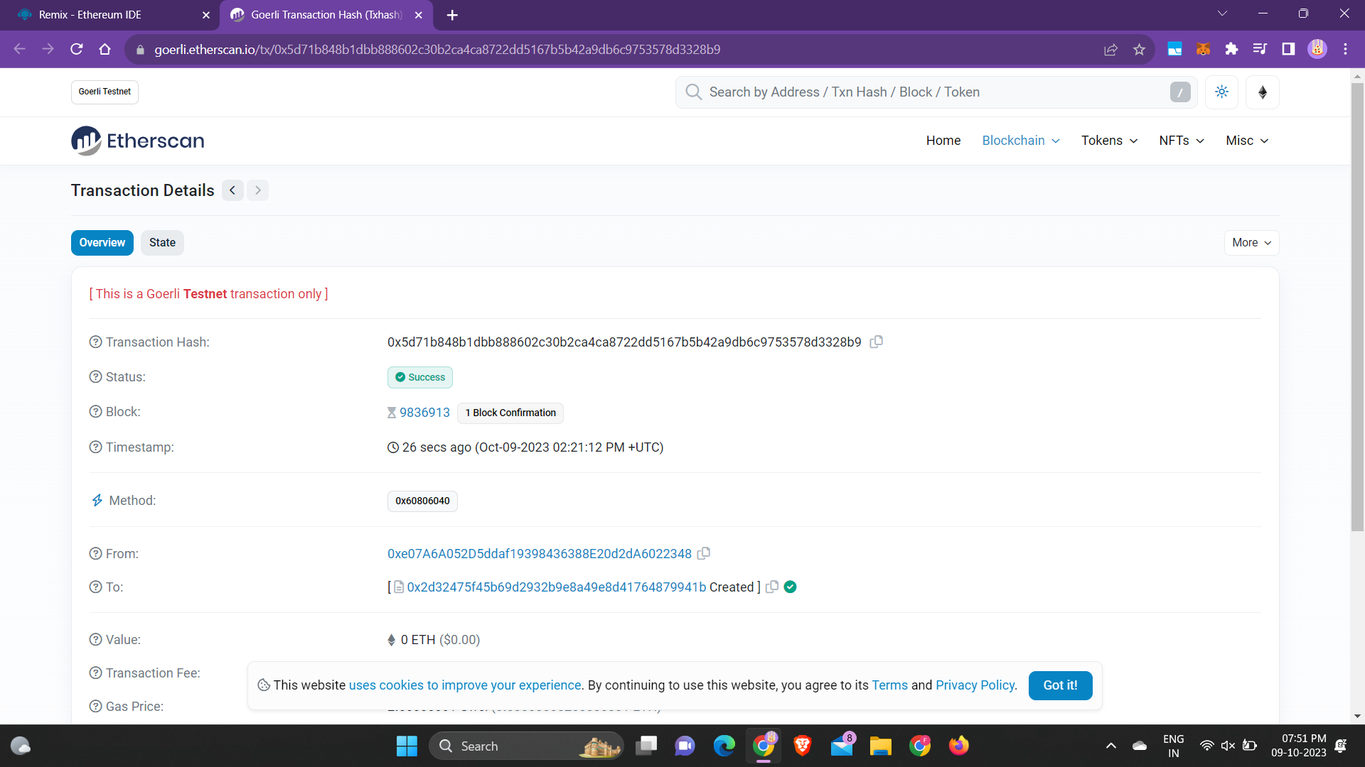

Slide 16
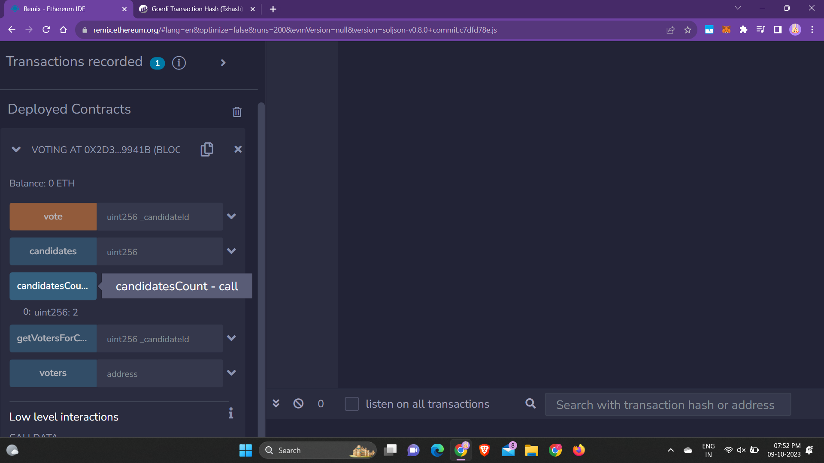

Slide 17
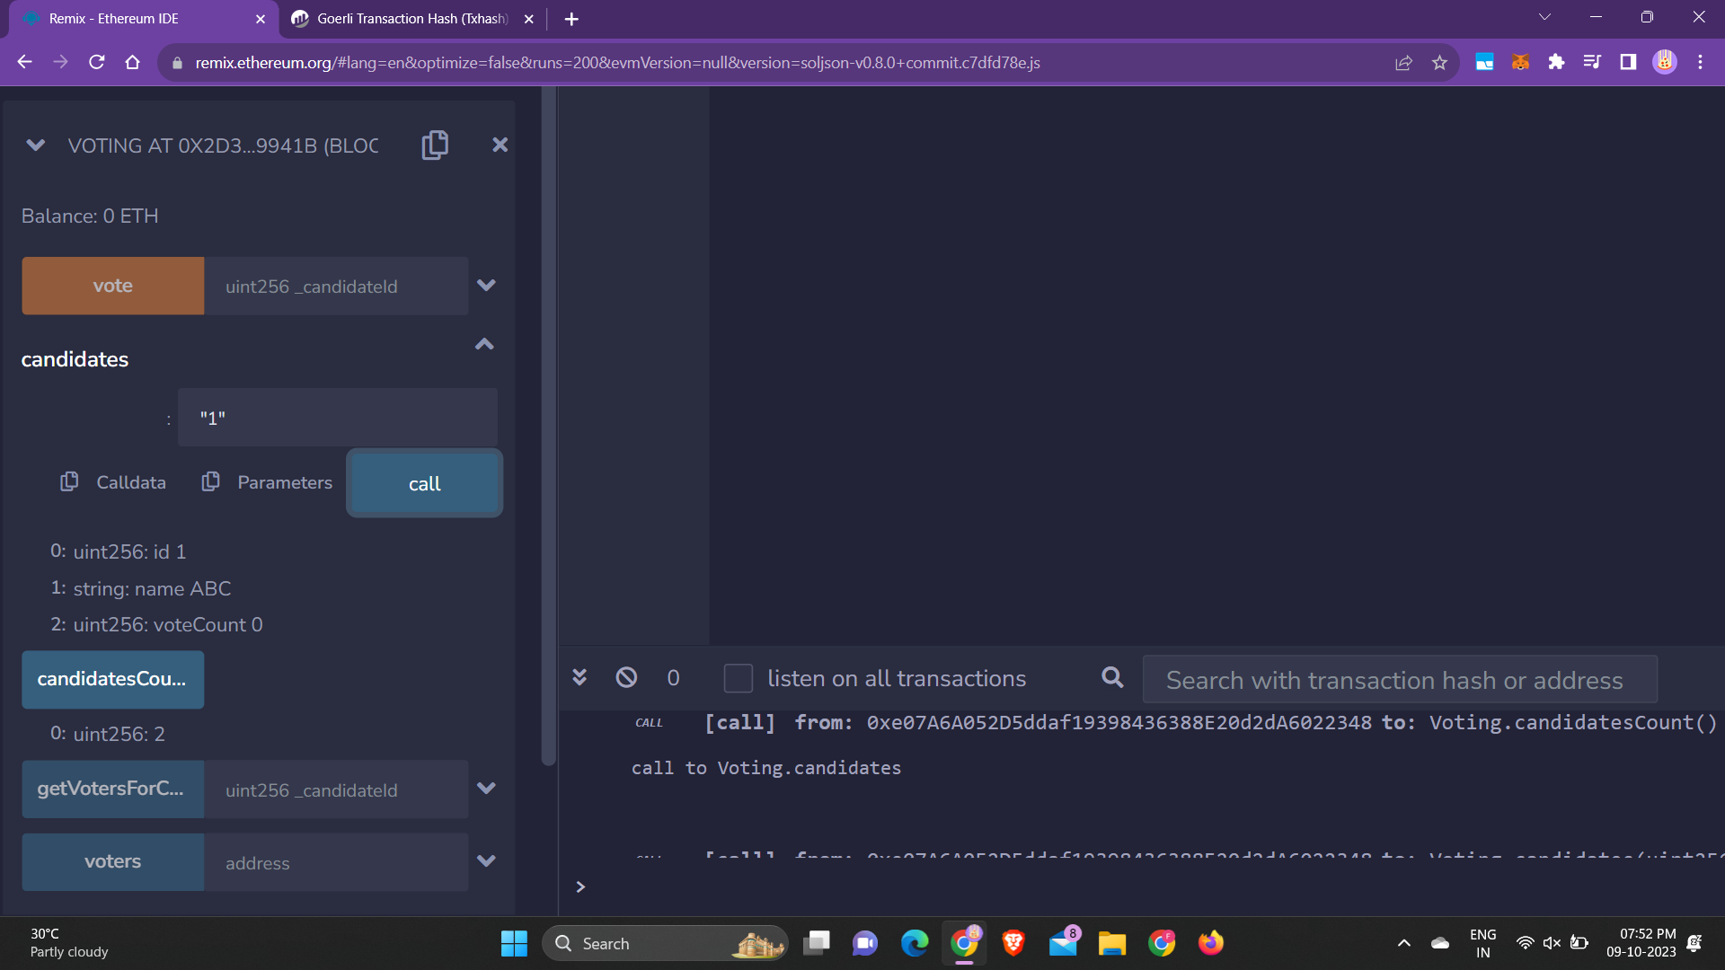

Slide 18
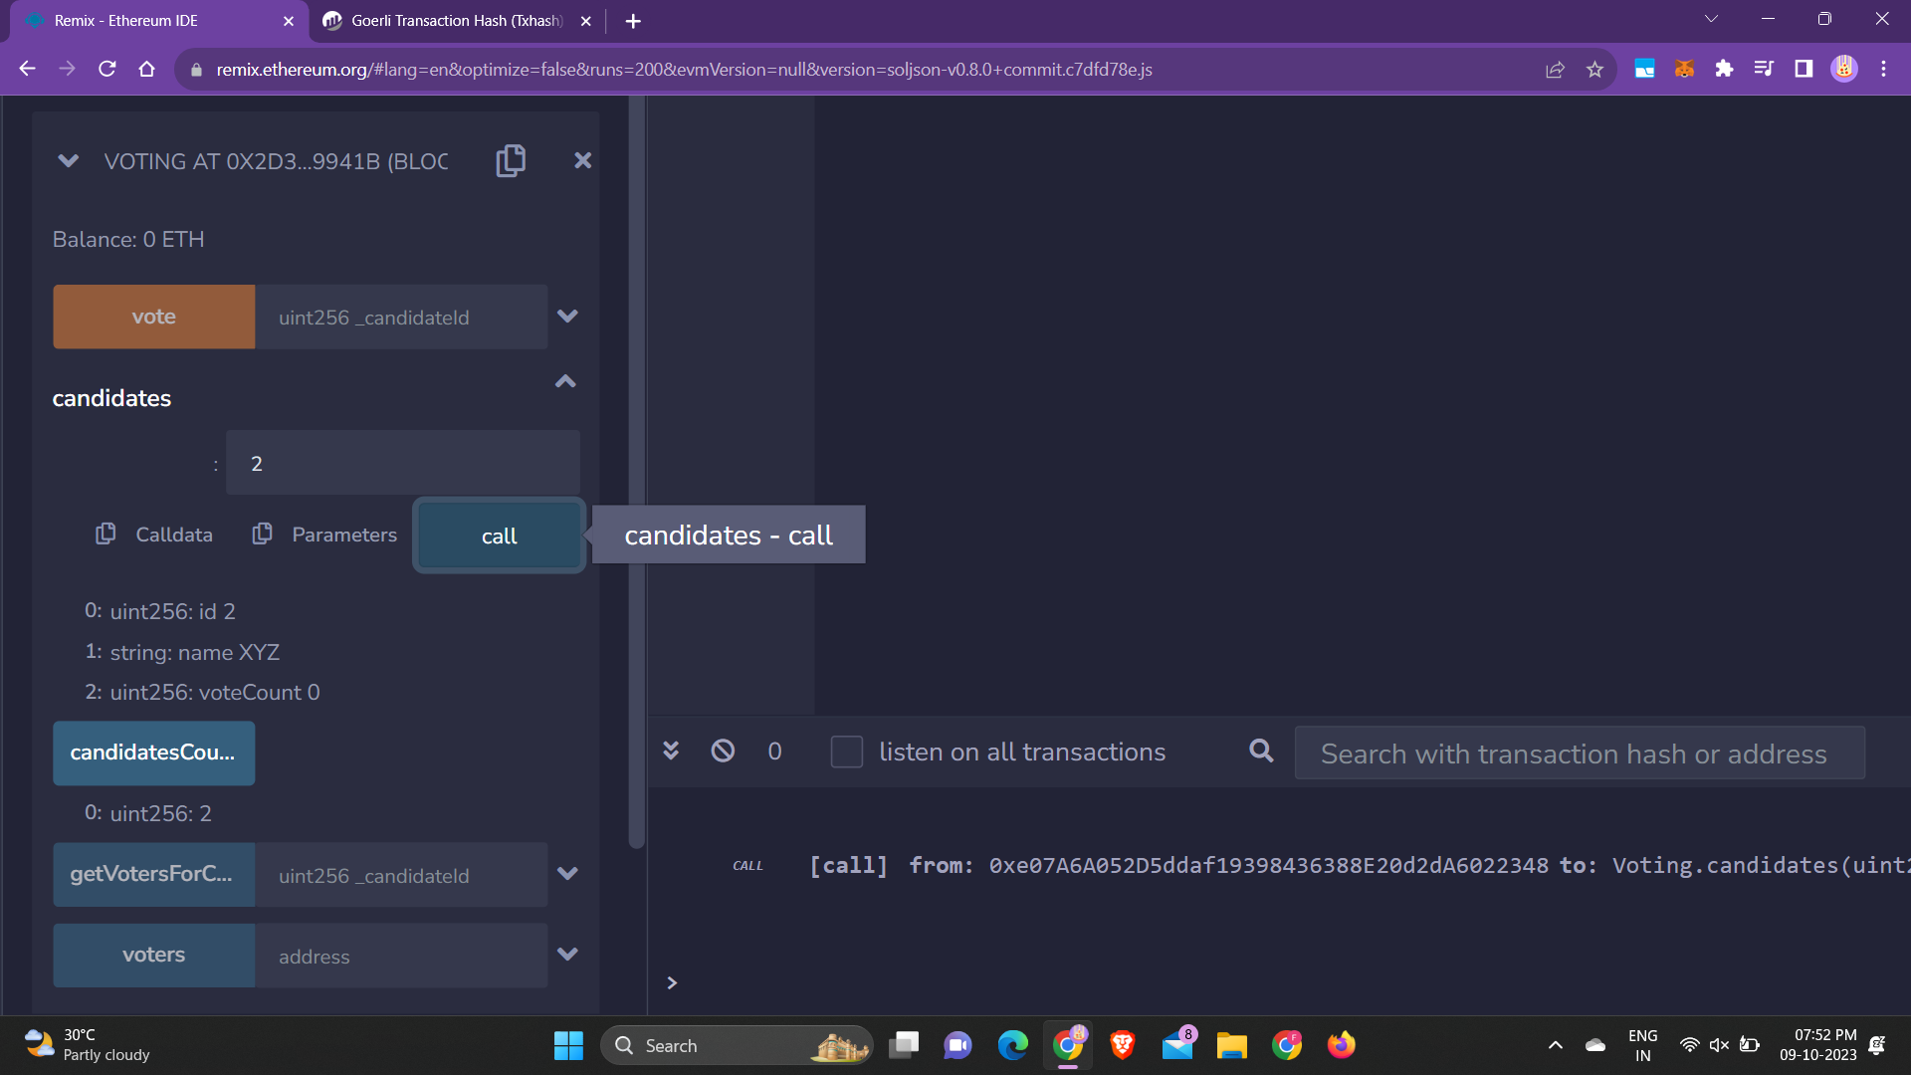

Slide 19
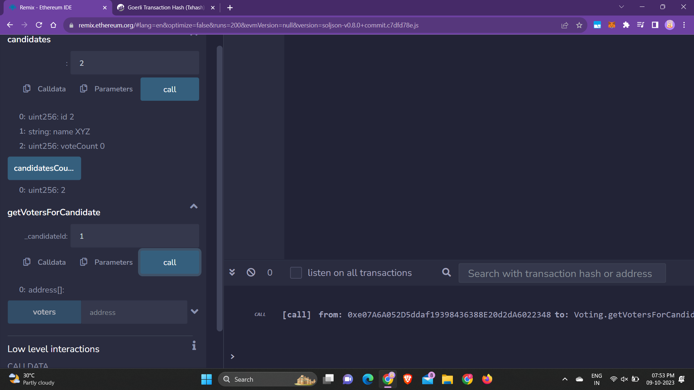

Slide 20
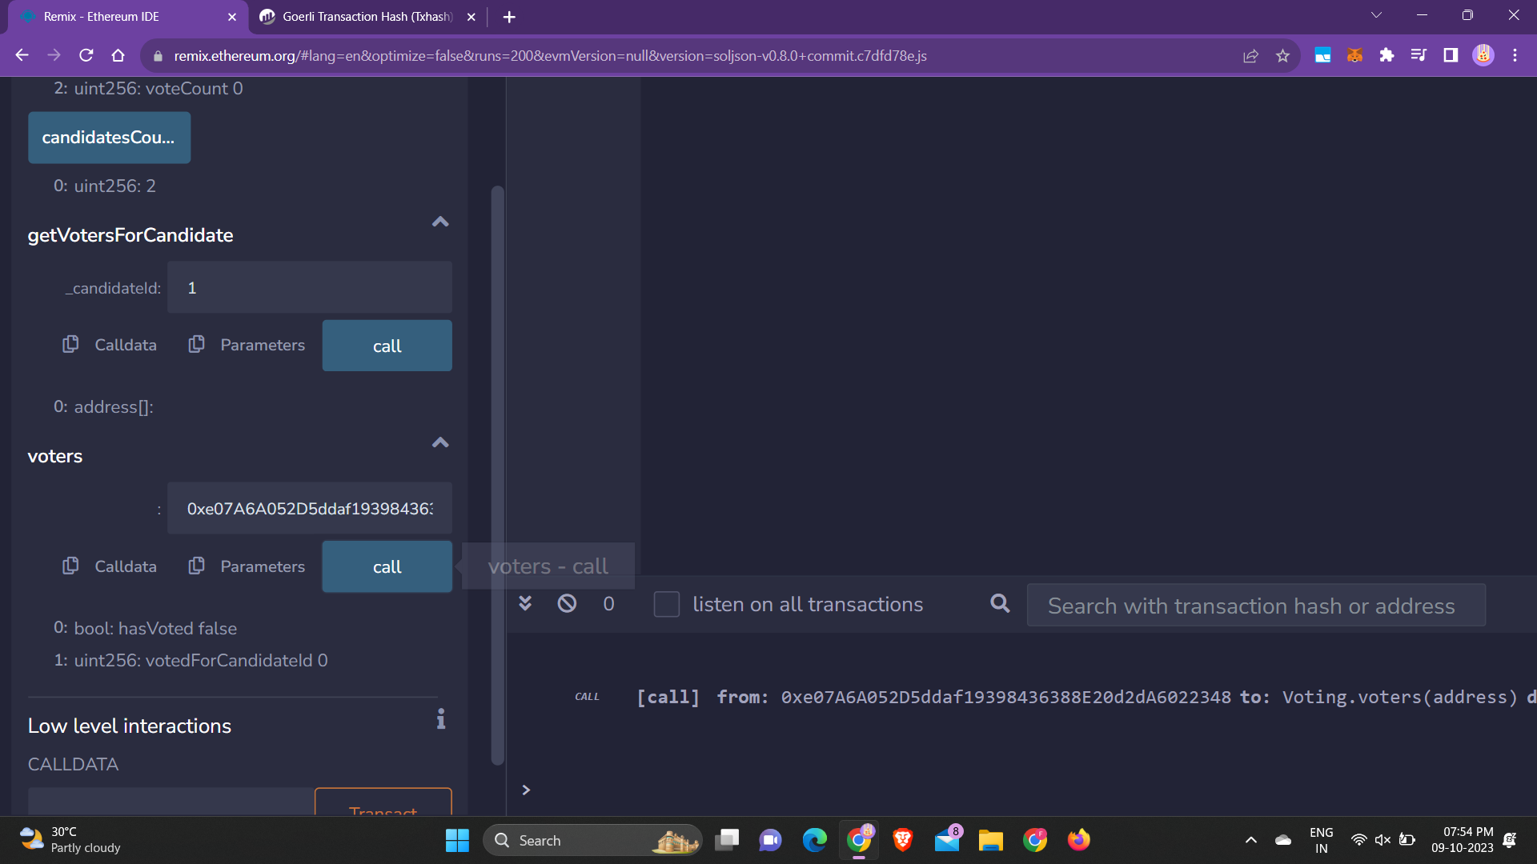

Slide 21
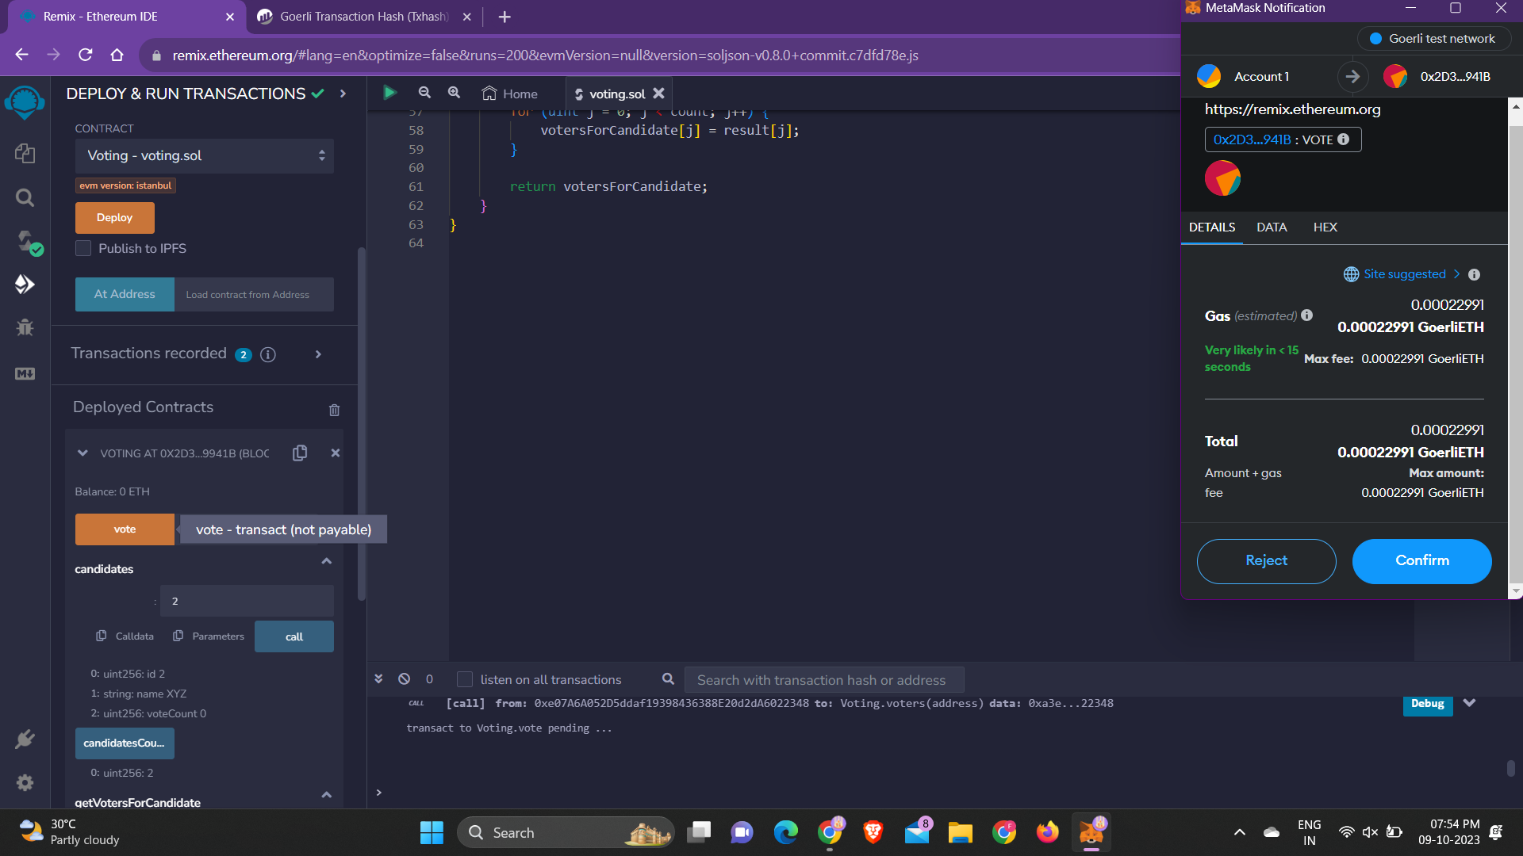

Slide 22
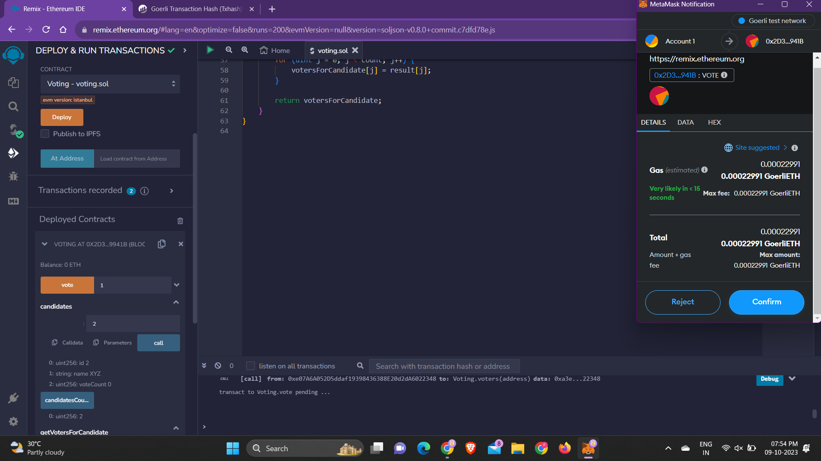

Slide 23
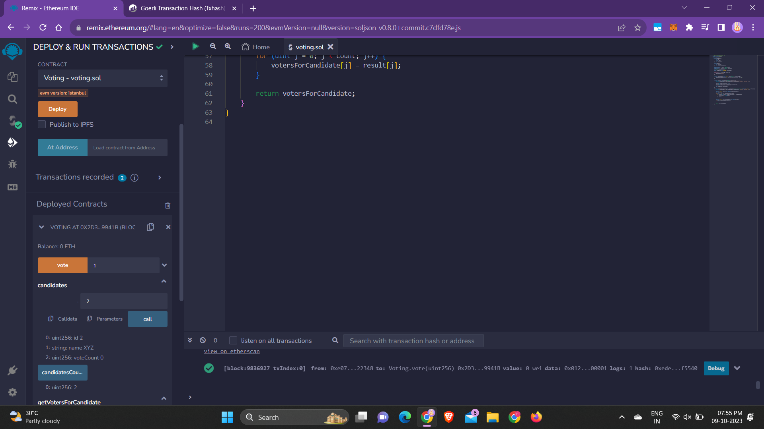

Slide 24
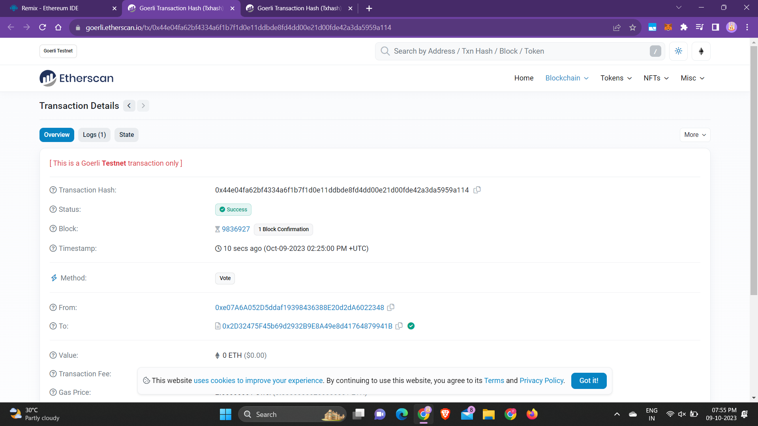

Slide 25
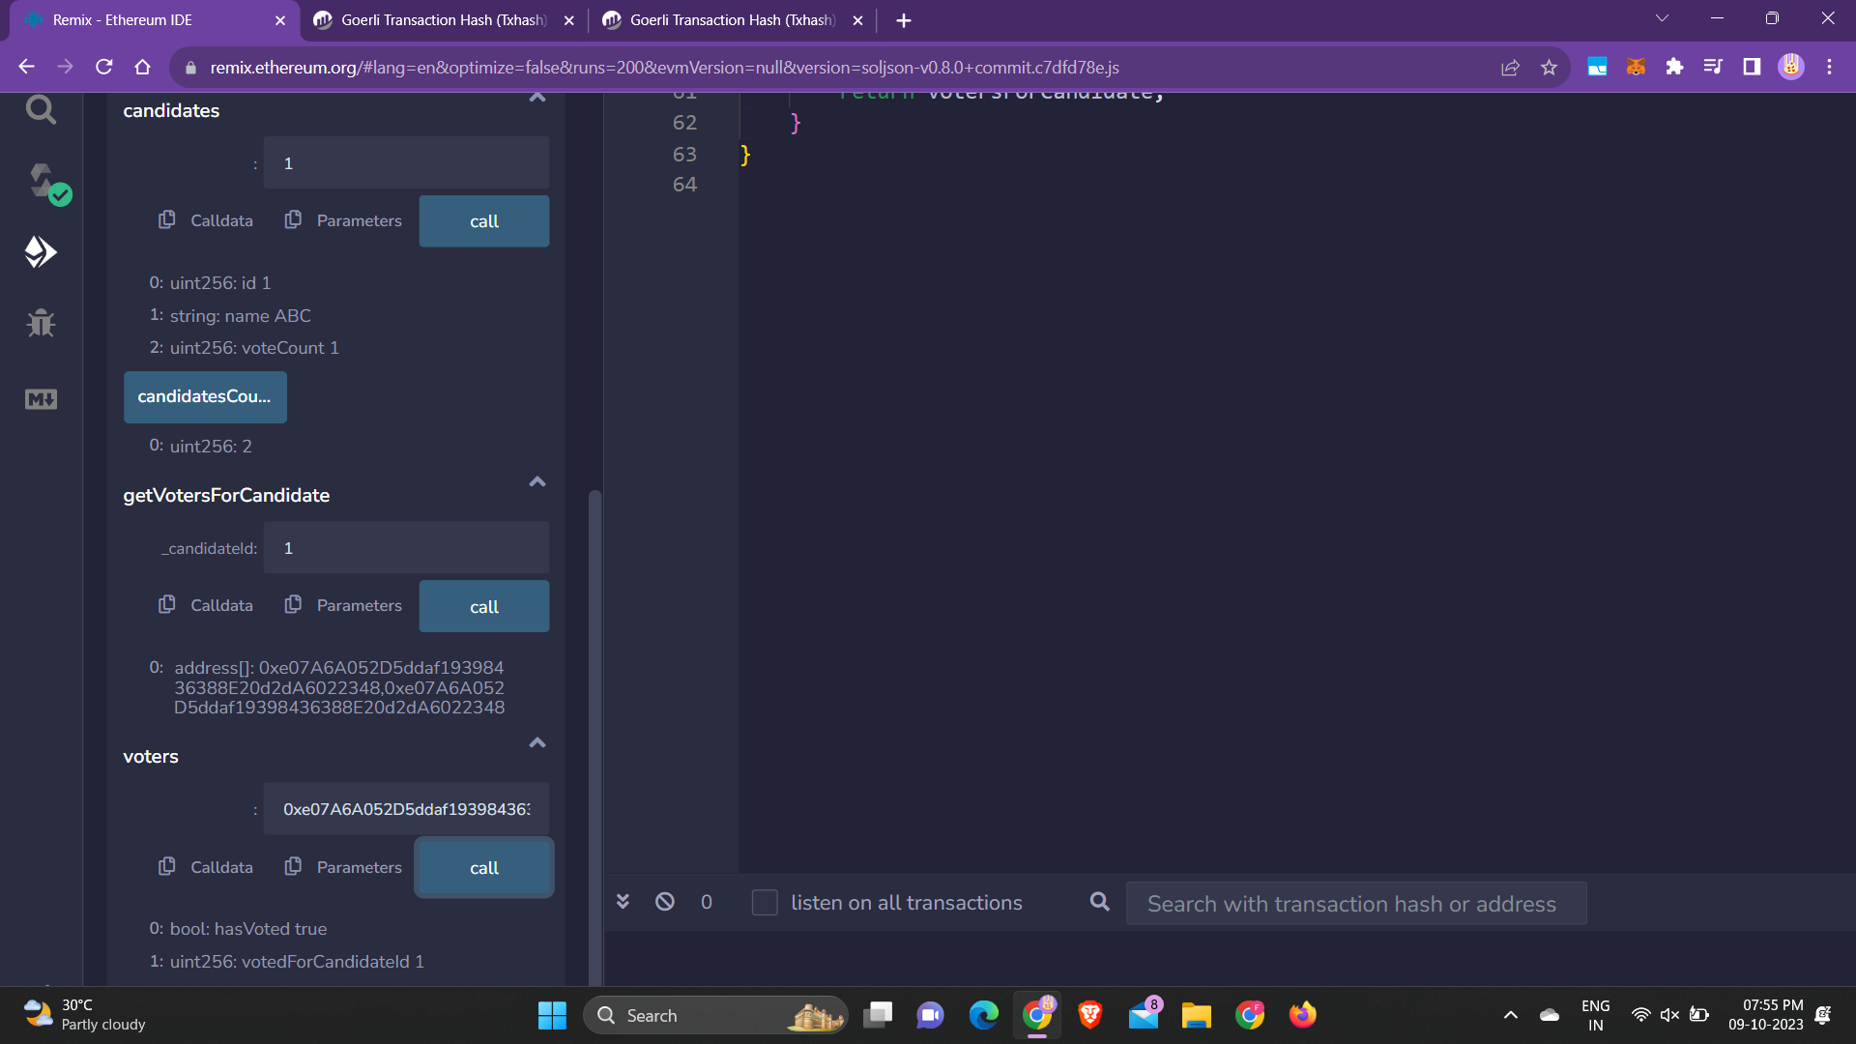

Slide 26
CONCLUSION
Developing a voting decentralized application (DApp) represents a significant step towards enhancing the democratic process in a secure, transparent, and accessible manner. By harnessing the potential of blockchain technology, our proposed DApp offers a user-friendly platform for individuals to exercise their voting rights with confidence.

